Slide 1
LED PCB DESIGN

Slide 2
agenda
Introduction
LED Chaser Circuit
PCB Design & Routing
EMI/Signal Integrity
Conclusion

Slide 3
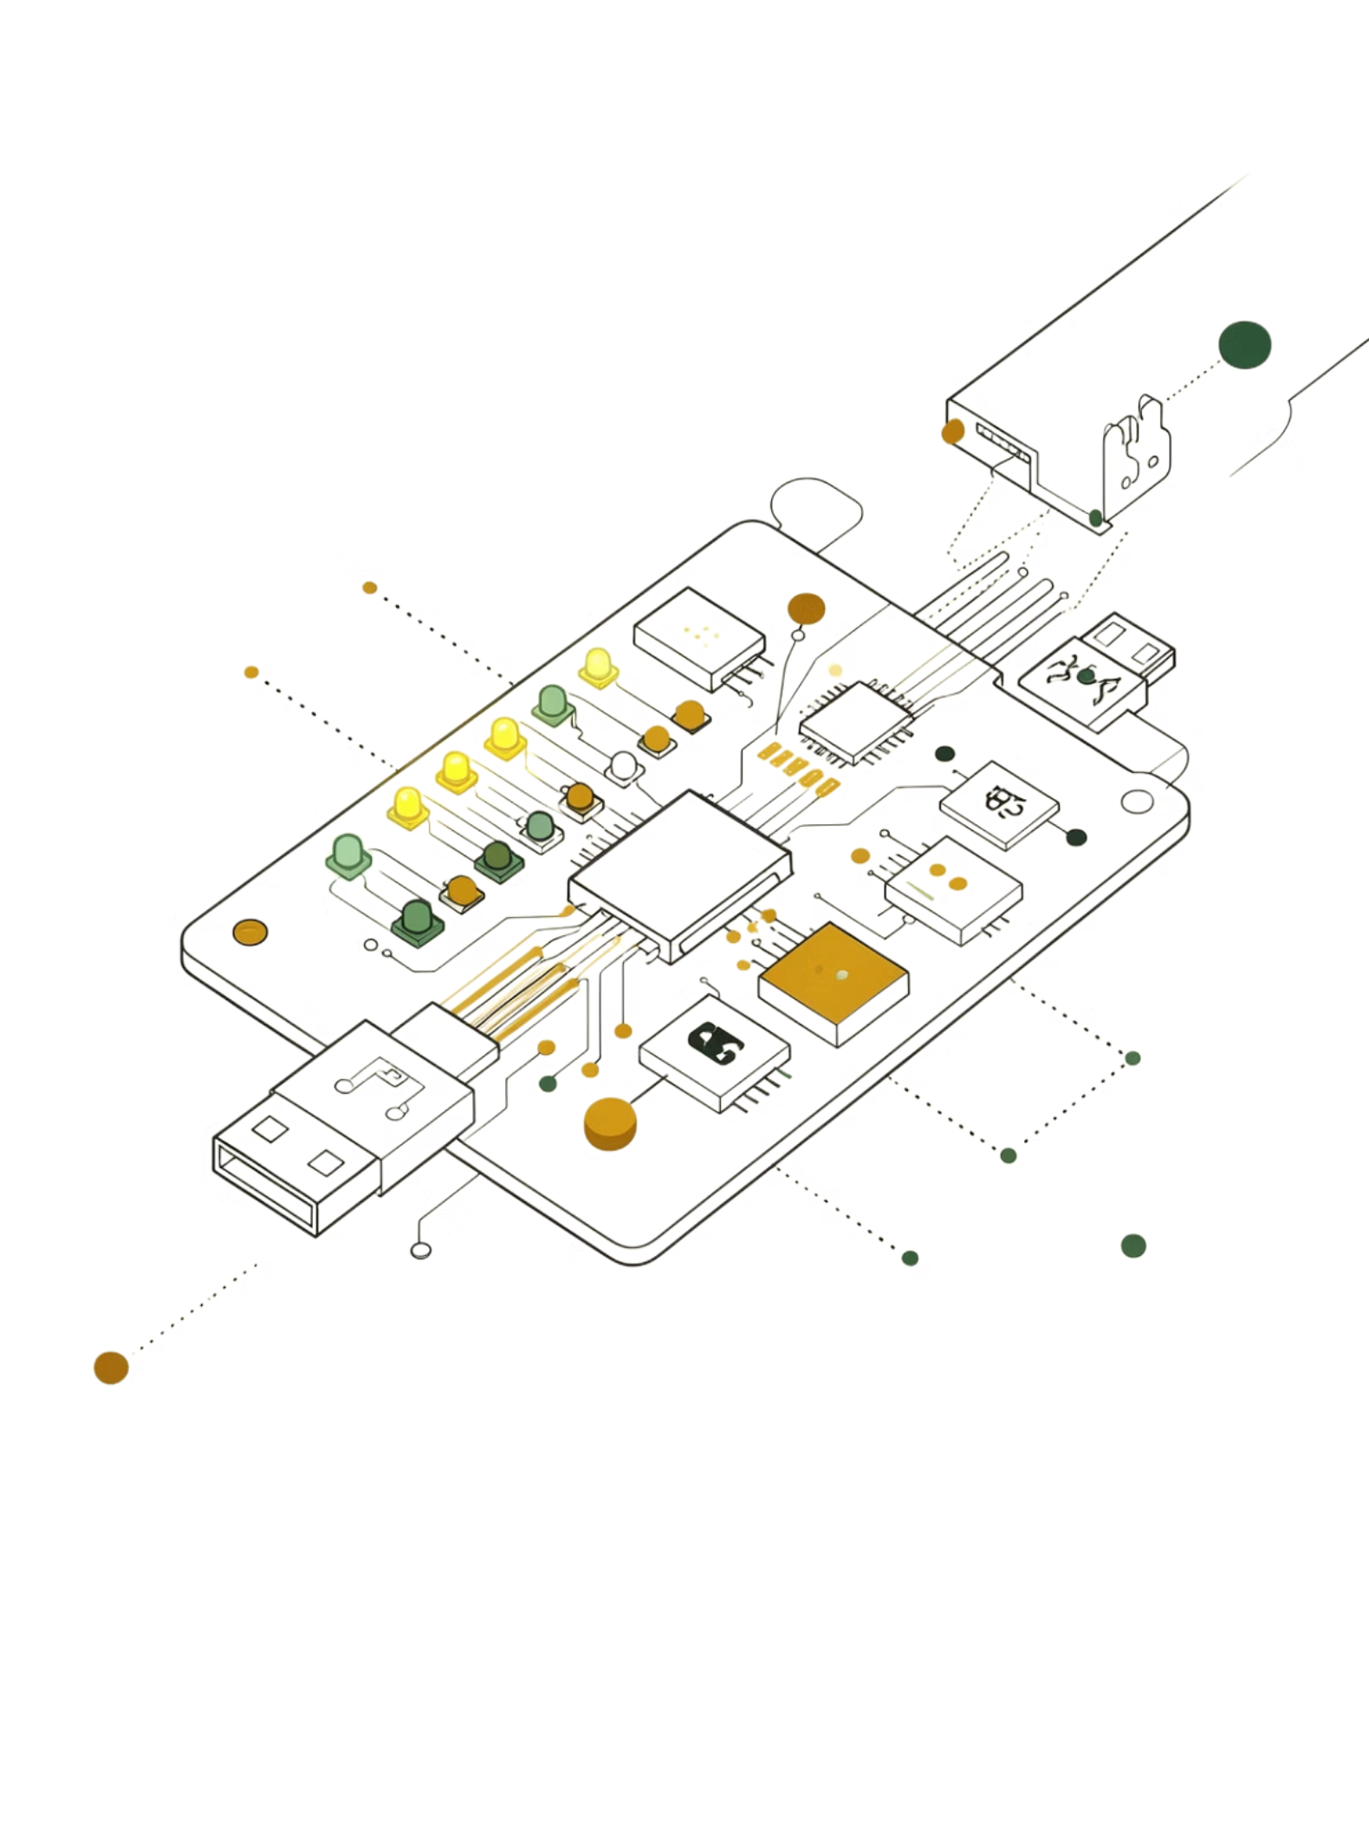
INTRODUCTION
To understand the complete PCB development from schematic to fabrication.
To study both single layer PCB.
To understand component placement, routing and grounding strategies.
To gain practical knowledge in PCB fabrication, soldering, testing and debugging

Slide 4
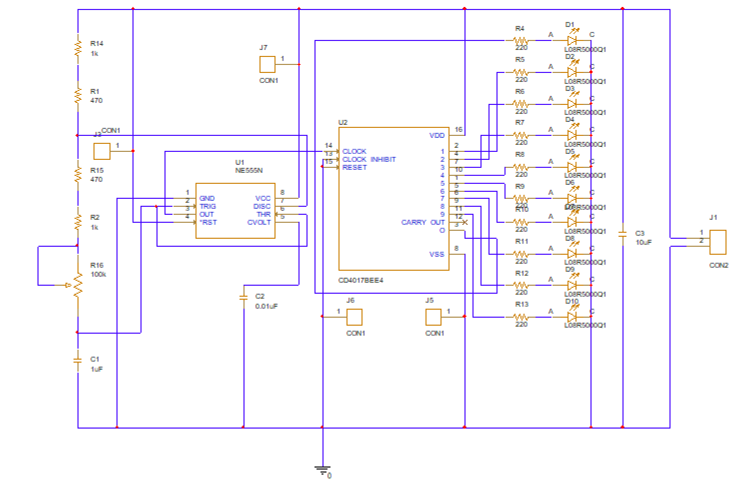
LED CHASER CIRCUIT
Components
NE555 Timer IC
CD-4017 IC
LEDs
Resistors
Capacitors
Potentiometer

Slide 5
WORKING
Power Supply Stage
Circuit powered using 5V/9V DC supply
Power given to IC555 and CD4017
Common ground maintained throughout circuit
IC555 Timer Operation
Operates in astable multivibrator mode
Continuously generates clock pulses
Output pulses produced at pin 3
Charging and Discharging Process
Capacitor charges through resistors
Discharges through IC555 timer
Generates continuous oscillations
Frequency Control
Potentiometer changes resistance
Controls pulse frequency
Adjusts LED blinking speed
CD4017 Decade Counter Operation
Receives clock pulses from IC555
Activates outputs sequentially
Drives LEDs one after another
Sequential LED Glowing
LEDs glow in running sequence
One LED turns ON at a time
Creates chasing light effect
Reset Operation
Counter resets after final output
Sequence restarts automatically
Ensures continuous looping operation
Power Supply Stage
IC555 Timer Operation
Charging and Discharging Process
Frequency Control
CD4017 Decade Counter Operation
Sequential LED Glowing
Reset Operation

Slide 6
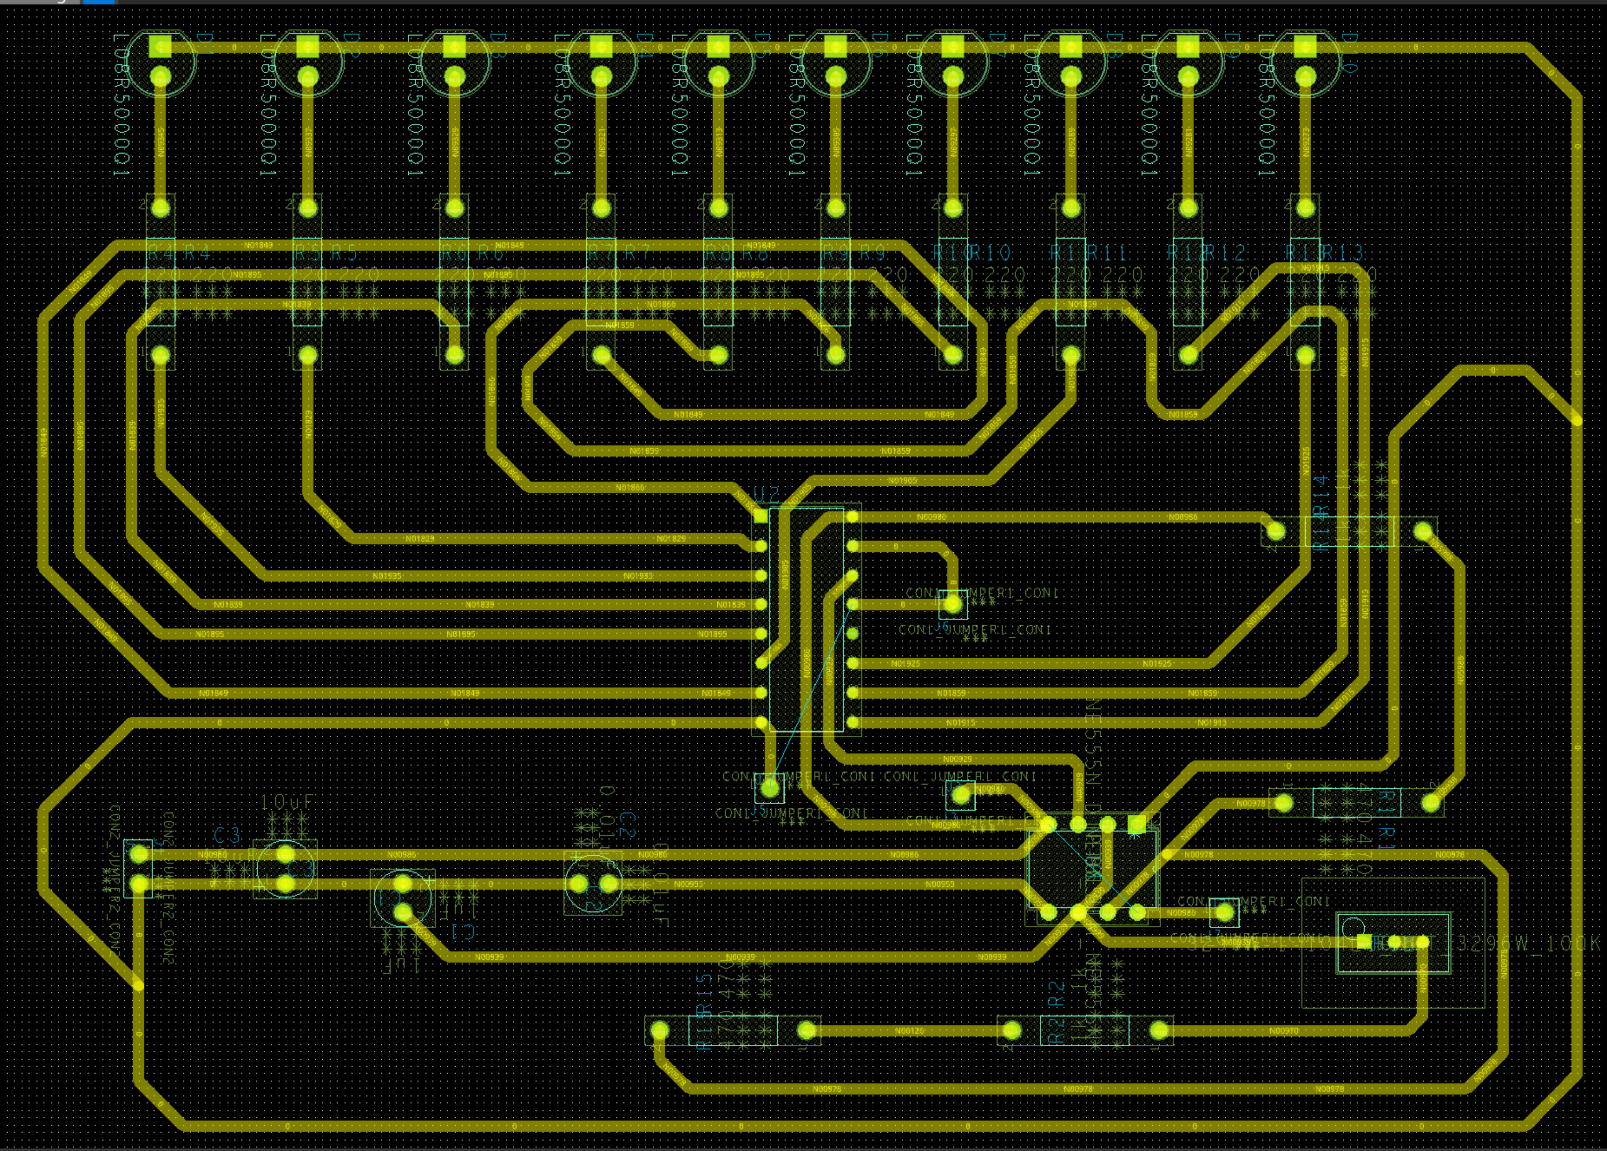
Single layer design (led circuit)

Slide 7
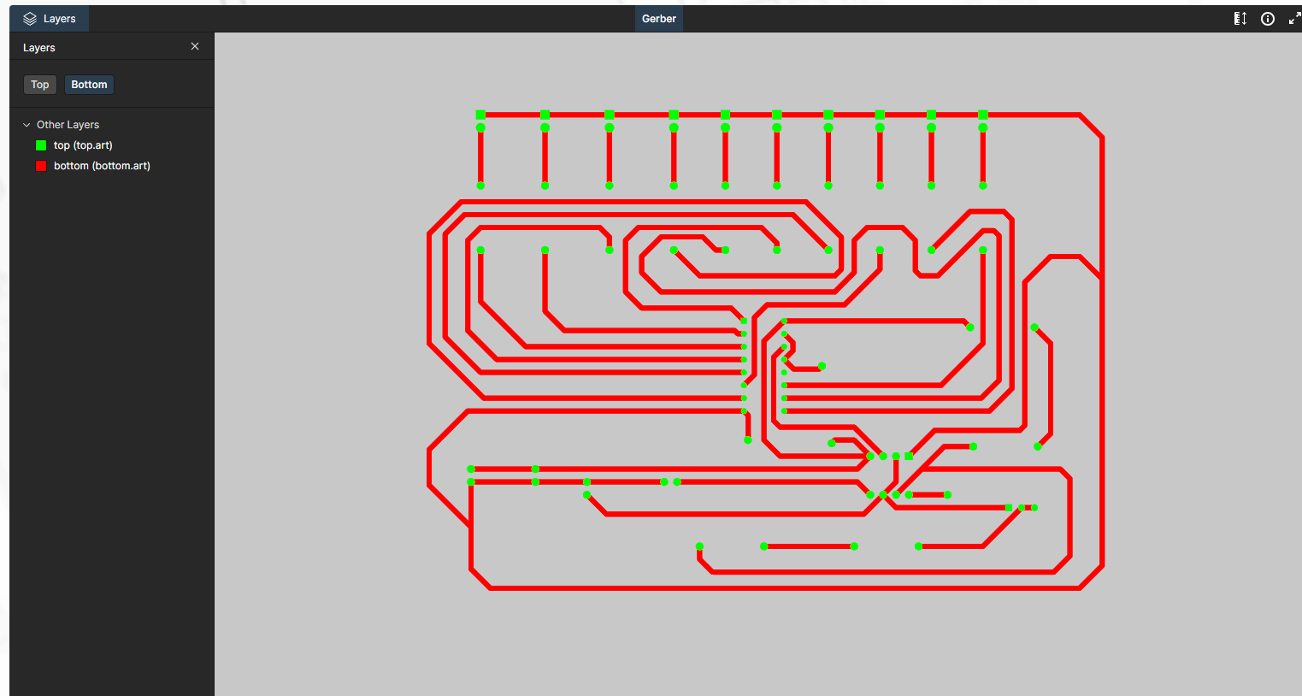

Slide 8
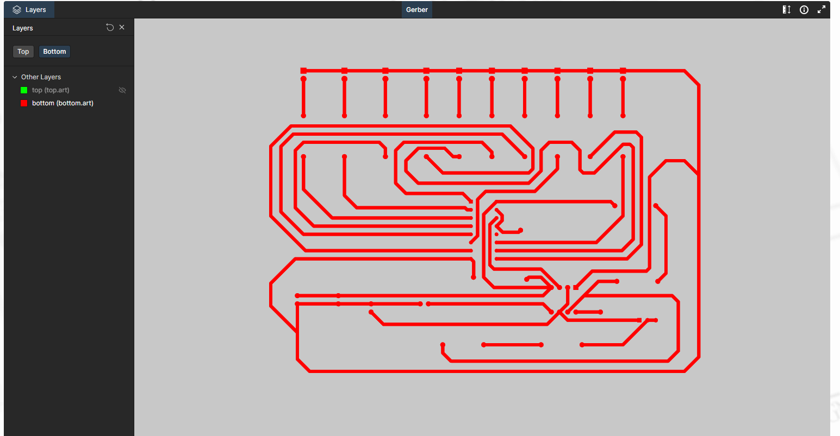

Slide 9
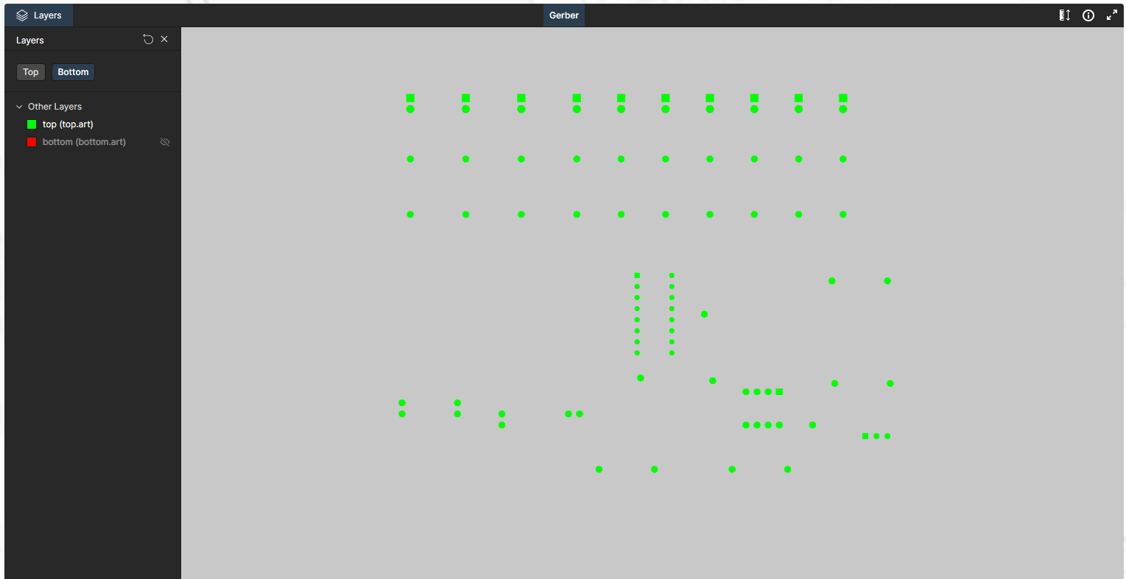

Slide 10
EMI/EMC
Signal integrity
Ground plane implementation
Decoupling Capacitors
Reduced switching noise
Proper routing paths
Differential pair routing
Length matching
Controlled impedance
Reduced crosstalk

Slide 11
CONLUSION
Successfully designed and implemented PCB projects
Developed practical understanding of single-layer PCB design
Improved practical skills in:
PCB fabrication
Soldering
Testing
Hardware debugging

Slide 12
Thank you

